Slide 1


ITE-7101: COMPUTER PROGRAMMING
AMA Computer University
Master of Science in Computer Science
Course Project Presentation
Presented By: Ramon Villamangca
Notes:
Good day, this is Ramon Villamangca. Today I am going to present to you the course project for ITE-7101 Computer Programming. ITE-7101 is one of the prerequisite courses required for graduate program MS Computer Science in AMA University. <click>

Slide 2


Presentation Outline
Part 1 | C++ Topical Presentation
Through the Loops
Dimension of Data Types
Introduction to Function Procedures
Part 2 | Programming Exercise
Prerequisite Topics to Part 2
Statement of the Problem
Solution to Programming Exercise
Notes:
This presentation comprises of 2 parts. <click> The first one is the Topical Presentation. <click> And, part 2 is the Programming Exercise. <click>
The first part has 3 sections: (1. Through the loop…). I chose this topic because I am for the most part a functional programmer and most of the concepts in modern C++ is in the focus in replacing loops with functional approaches, introduction of new and more specific data types and the focus on FP rather than OOP. <click>
Part 2 has 3 sections. The first section is a rundown of prerequisite topics needed for our exercise solution. These are concepts that are not taught in the course module and would give us a more modern approach to our solution. The second section we will read the problem statement. And the final section is the actual video of our solution.
With that let’s start our journey! <click>

Slide 3
Part 1: Topical Presentation
1. Through the Loops
Loops is programming is a flow control mechanism that allows a code block to be executed repeatedly, in the process called “iteration”.
Types of C++ Loops
C++ provides for both imperative and functional constructs of looping:
Imperative Loops:
Imperative For Loop
While Loop
Do-While Loop
Functional Loops:
Range-based For Loop
For-Each Loop
Notes:
(Loops is a programming…) <click> (C++ provides for both…) We will discuss both of this constructs. <click>. The imperative loops in C++ are: (Imperative…). <click>. While the functional loops are: (Range…). These are called “functional” because it tries to adhere to adhere the functional principle of “no side effects”. I will explain it when we get there. <click>

Slide 4
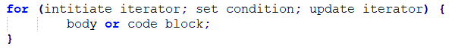
Part 1: Topical Presentation
1. Through the Loops
Imperative For Loop
Imperative For Loop is type of looping in which the number of iteration is clearly mentioned before the start of iteration. The code syntax is as follows:
An example will make this clearer.
Notes:
Now, we begin with Imperative For Loop. <click>. (Imperative…) <click>. For loops starts with the keyword “for” followed by the following inside parenthesis: the initial value of the iterator, a conditional statement stating the limit of iteration and the modification to be made to the iterator in each step of the iteration. All the parameters inside the parenthesis are separated by semicolon. This is then followed the code block (loop body) intended to be repeated, enclosed in curly braces. <click>. (An example…) <click>.

Slide 5
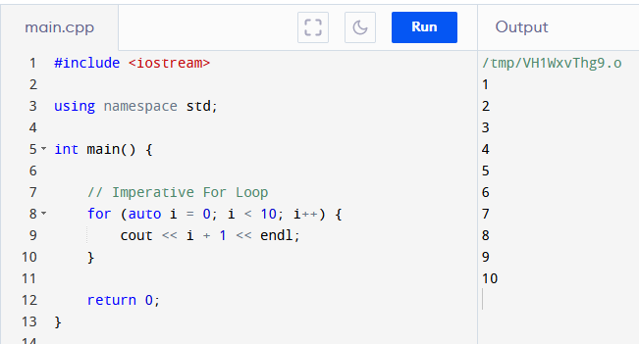
Part 1: Topical Presentation
1. Through the Loops
Imperative For Loop (Example)
Notes:
So in For loop. We first initiate the iterator. <highlight>. In this case i=10. (Don’t worry about the keyword “auto”, I will discuss it when we get to part 2).
Then we set the condition or limit. <hightlight>. That is i<10. Then we tell the loop how to update the iterator in each step of iteration. <highlight>. That is increment by one. And then <highlight> we go to the loop body which tells the program what to do while the condition is still met. In this case print the value of i+1. <higlight> The output is the program prints numbers from 1 to 10 to the screen. <click>.

Slide 6
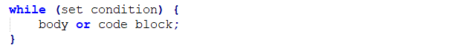
Part 1: Topical Presentation
1. Through the Loops
While Loop
While Loop is type of looping in which the loop body will only be executed “while” certain condition is still satisfied. If the condition failed, the loop terminates. The code syntax is as follows:
An example will make this clearer.
Notes:
Next we discuss while loops. (While Loop…) <click>. While loops starts with the keyword “while” followed by the condition to “continue” the loop, inside parenthesis, followed by the code block (loop body) intended to be repeated, enclosed in curly braces. It can also support iteration, but the iterator must be declared before the start of the while-block. <click> (An example…) <click>.

Slide 7
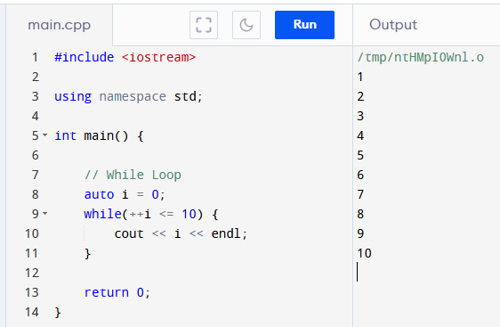
Part 1: Topical Presentation
1. Through the Loops
While Loop (Example)
Notes:
So in while loop. If there is an iterator (in this case “i”) we first initiate it “i=0” <highlight>. Then we set the condition <click>. In this case increment i and compare to 10. <highlight> And then <click> we go to the loop body which tells the program what to do while the condition is still met. In this case print the value of i. <highlight> The output is the program prints numbers from 1 to 10 to the screen. <highlight> <click>.

Slide 8
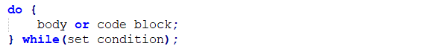
Part 1: Topical Presentation
1. Through the Loops
Do-While Loop
Do-While Loop is variation of the While Loop wherein the conditional statement is at the end of the code block. The code syntax is as follows:
An example will make this clearer.
Notes:
(Do-While…) <click>. Do-While loops starts with the keyword “do”, followed by the code block (loop body) intended to be repeated, enclosed in curly braces, followed by the “while” condition to “continue” inside parenthesis. Note that the “while” condition needs to be terminated by a semi-colon (;). Having the loop body in front of the condition, ensures that the body will execute at least once. <click> (An example…)

Slide 9
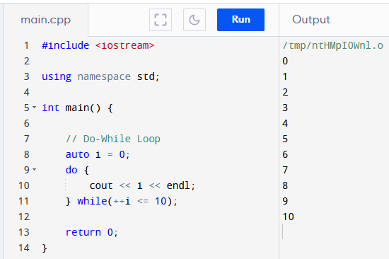
Part 1: Topical Presentation
1. Through the Loops
Do-While Loop (Example)
Notes:
As in while loop. If there is an iterator (in this case “i”) we first initiate it “i=0” <highlight>. Then <highlight> we go to the loop body which tells the program what to do while the condition is still met. Then we set the condition at the end of the block<highlight>. In this case increment i and compare to 10. <highlight> And In this case print the value of i. <highlight> The output is the program prints numbers from 0 to 10 to the screen. <highlight>. The output is different from while loop <highlight> although they have the same condition. This is because in do-while <highlight> the body is run first before the condition. Allowing it to print “i” before it is ever updated. <click>

Slide 10
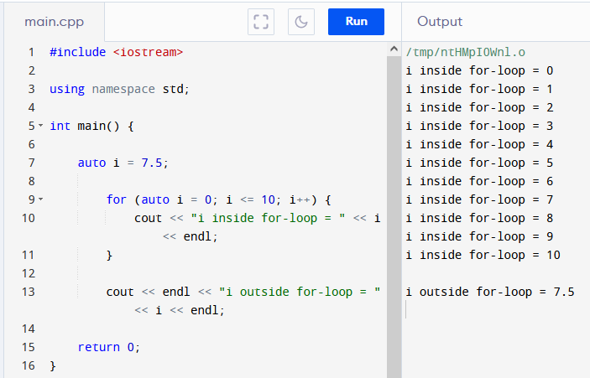
Part 1: Topical Presentation
1. Through the Loops
Scope and Variable Lifetime
A local variable is only valid in the code block it resides on. The validity of a local variable within a code blocks is called its scope.
Variables created inside a loop, lose their scope when the loop ends.
Notes:
Before we continue with the other loop types, we first discuss a few important concepts. First we have <click> (Scope and…) . We also say that the local variable has a lifetime only up to it gets out of scope. Variables are just locations in memory. When a variable goes out of scope the memory allocated to it in the block is freed for use of other processes. <click>
In this example the variable “i” inside the for-block <click> is not the same as the variable “i” outside <highlight>. As we can see <highlight> the value of variable “I” inside the block is increasing while the outside “I” value remains the same.
Since the loops we learned so far are essentially code blocks, we need to know that, <click> (Variables…) This is the reason why While-Loops are not recommended to do iteration as the iterator has to be declared outside the loop’s code block. That means the iterator memory allocation is not released when it gets out of scope. Leaving us with an extra variable that we may or may not be able to reuse.

Slide 11
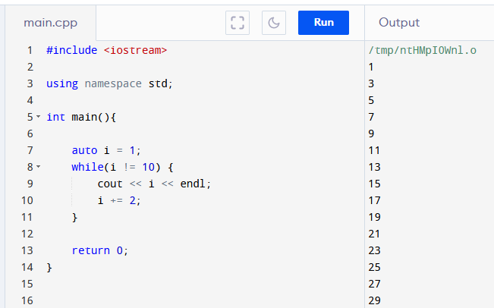
Part 1: Topical Presentation
1. Through the Loops
Infinite Loop
The situation wherein the terminating condition can never be satisfied and therefore the loop cannot terminate, is called Infinite Loop.
Notes:
Loops rely on conditions and limits in order in order to terminate. A well-designed loop should terminate gracefully when the terminating conditions are met. This is not always the case, though. <click> (The situation…) In an infinite loop goes on and on and until your program crashes. This is very bad for your program… and maybe your refutation. So, infinite loop should be avoided as much as possible.
<click> (Example) In this example the condition <click> cannot be attained because “I” is only having odd integer values. In the online compiler I am using the program stops when “i=5999”. But on a real app this can potentially run longer than that and eventually it will crash.
There is some use though, for infinite loop however you must know how to exit from infinite loop, which we will discuss in the next slide.

Slide 12
Part 1: Topical Presentation
1. Through the Loops
Break and Continue Statements
Break statement halts the execution of all statements inside the loop, after the “break” and terminates the loop completely.
Continue statement halts the execution of all statements inside the loop, after the “continue” and returns to the start of the loop.
An example will make this clearer.
Notes:
There is a way to prematurely halt the execution of any loop whether infinite loop or not. This is through the use of <click> Break and Continue Statements. <click> (Break…) Break is also use to handle cases in a switch statement but that is outside the scope of this presentation. <click> (Continue…) That means that in this case the loop does not terminate but start over again to the next iteration. <click> (An example…) <click>

Slide 13
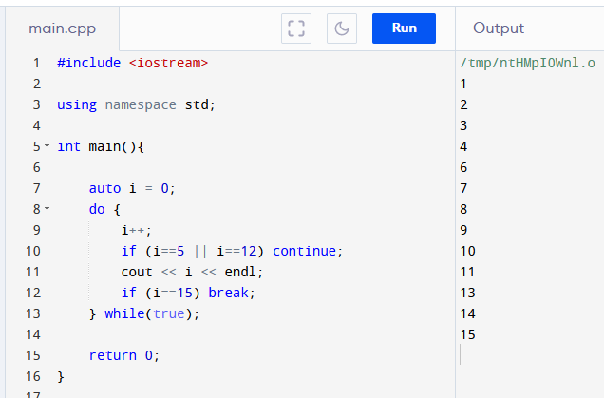
Part 1: Topical Presentation
1. Through the Loops
Break and Continue (Example)
Notes:
In this example, the do-while is potentially an infinite loop. This is because the condition <highlight> is always “true” and can never be changed. However, because we have this <highlight> condition and break statement, the loop will terminate at “i=15”. Also because of this <highlight> continue statement before the call to cout, the program will not print 5 and 12 in the screen, and instead shall continue to the next iteration. <click>

Slide 14
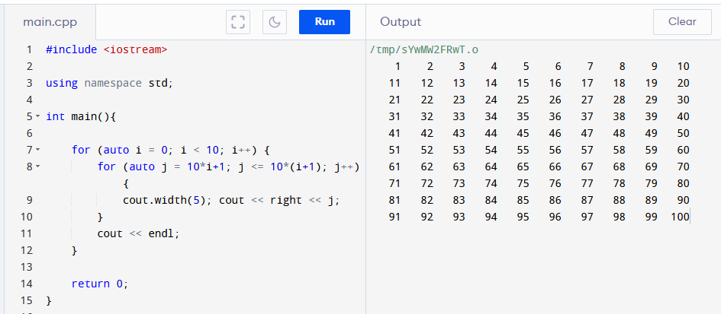
Part 1: Topical Presentation
1. Through the Loops
Nested Loops
Nested loops are loops inside another loop/s.
We need to be careful in using nested loops, as the number of steps is compounded by the number of loops.
Notes:
(Nested…) For example. <click> This program prints the first 100 natural numbers, 10 numbers in each line. The inner loop prints 10 numbers <click> on the screen and the outer loop commands to do the inner loop 10 times <click>. Therefore, <click> (we need…). Making the complexity of the operation to be in the power of the number of loops. In our example, we have 10 outer loops and 10 inner loops so we 10x10 or 100 steps. Imagine having 10 nested loops having 100 steps each. That would be 10^100 steps! Our program would have already crashed before the loop finishes.
Nested loop is one of the reason why a program is slow. The number of nested loops should minimalized. The ability to be nested indefinitely is one of the reasons why looping is not present in most FP languages. <click>

Slide 15
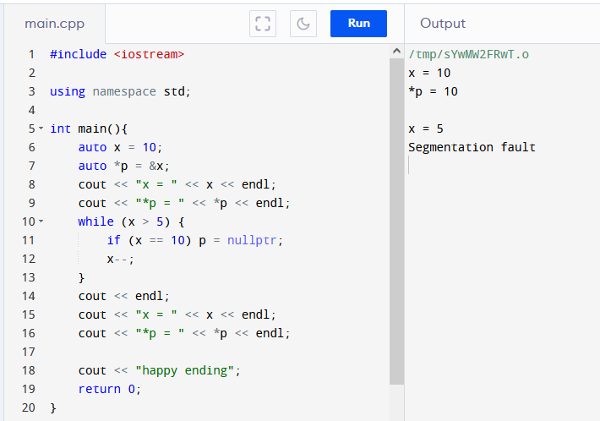
Part 1: Topical Presentation
1. Through the Loops
Side Effects
Side effect is the ability of code block to modify some states outside of its scope.
Notes:
Another reason why loops are frowned upon in the FP community is that it is able to have side effects. <click> (Side effect…). We can see this in our previous examples of while and do-while loops, wherein the iterators are defined outside of the loop and modified inside the loop. But imperative loops can also affect other states. <click> In this example we define a variable x with value 10 and we also defined a pointer p that points to x. <highlight> We print the value of x and p that clearly shows that p points to x. The while loop is able to change the value of x but also the state of p. By setting p = nullptr we are in effect deleting the pointer. <highlight> so when we try to print p again, we are faced with “segmentation fault error”, terminates the program and preventing us our <highlight> happy ending.
This is just a simple example. It is easy to spot the bug. Most of the times the solution is to declare local versions of variables, so we don’t accidentally modify variables outside the scope. We already saw that in our example in “scope and variable lifetimes”. But what if we have long, convoluted nested loops. Debugging can be tedious. This is the reason why that in the FP paradigm side effects are not allowed.
The ability to have side effects, infinite loops and convoluted nested loops are the reasons why most FP languages don’t have loop constructs instead recursion is encouraged. We shall discuss recursion when we get to the topic of functions…

Slide 16
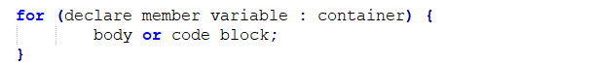
Part 1: Topical Presentation
1. Through the Loops
Range-based For Loop
Range-based For Loop is a way to iterate a container without changing or modifying the content of the container. The code syntax is as follows:
An example will make this clearer.
Notes:
Since 2011, the creators of C++ sought to modernize C++ by including, among other changes, FP paradigm to C++. One of the first changes is the introduction of <click> (Range-based For Loop…). <click> As you can see it has a much simpler and cleaner syntax than its imperative cousin. It begins with the keyword “for” (as usual) <click> followed by enclosed in parenthesis: a declaration of a member variable that represents an element of a container <click>, followed by a colon symbol <click>, followed by the container where the variable belongs and finally followed by the loop body. <click> The colon symbol is read as “inside of” or “an element of”. The container can be any type of data structure in C++. It can be arrays, vectors, lists, strings, etc. (An example…) <click>

Slide 17
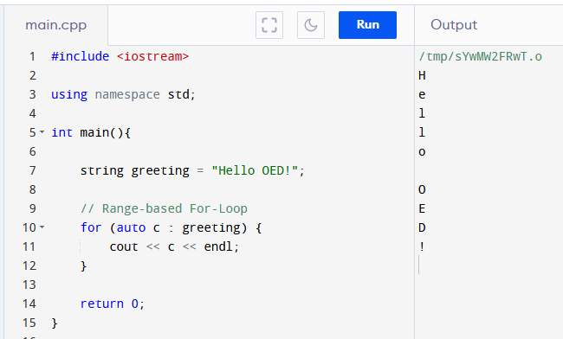
Part 1: Topical Presentation
1. Through the Loops
Range-based For Loop (Example)
Notes:
In this example, we declare a string called <highlight> “greeting”. We then started a range-based for-loop to iterate through “greeting”. <highlight> We defined an uninitialized variable “c”, that represents each character in “greeting”, followed by a colon, and then the container string “greeting”. In the body we print each character followed by an “endl” causing the “greeting” to be printed vertically. Note that the reason the characters are written correctly is because string is sequential. For non-sequential data structures like sets, maps and trees, there will be no guarantee that the elements will be process in the order we expect. Also note that range based for loop is not purely functional in the sense that the body of the loop can contain codes that modify external state. Like in our example cout is changing the state of the output stream in each step.

Slide 18
Part 1: Topical Presentation
1. Through the Loops
For-each Loop
Like the range-based for-loop, For-Each can be applied to elements of a container. But it is actually a function taking in three parameters. The code syntax is as follows:
An example will make this clearer.
Notes:
Another functional loop type is the for-each loop. <click> (Like the…) <click> The loop starts with for (underscore) each, followed by inside parenthesis, a pointer to the element of the container where the function is first to be applied, followed by a pointer to the last element in the container where the function is to be applied, followed by the function itself. <click> (An example…) <click>

Slide 19
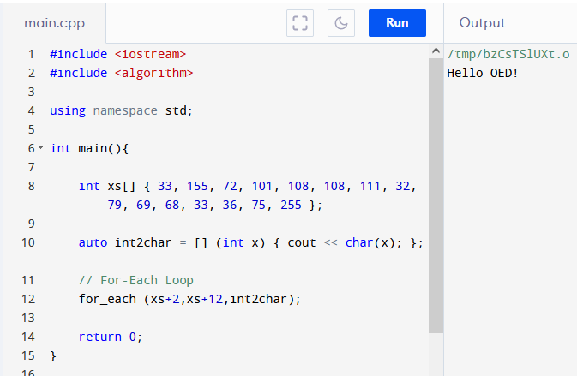
Part 1: Topical Presentation
1. Through the Loops
For-each Loop (Example)
Notes:
In this example, we declare an array of integers called <click> “xs”. <click> Notice that there is no equal sign between the variable and the initialization list. This is called uniform initialization a concept introduced in modern c++ to allow initialization without assignment.
Now for the for-each loop. <click> We are interested only of 3rd and the 12th elements of xs, so we input the pointer to those elements as the first 2 arguments to the for-each function. The last argument has to be a function. So we creates a lambda function <click> that casts an int to a char and prints on the screen. We’ll discuss about lambda functions when we come to the topic of functions.
The final output of the for-each expression is printing “Hello OED!” to the screen.
So, having discuss all the looping constructs possible in C++, we are now ready to discuss the next topic, which is… <click>.

Slide 20
Part 1: Topical Presentation
2. Dimensions of Data Types
Data Type refers to the type of value a variable has. Data types has size which is the amount of memory will be allocated to a certain data type.
Primitive Data Types and Sizes
The “sizeof” and “typeid” Operators
C++ STL Arrays and Dimensions
Derived Data Types and Sizes
Notes:
We are now going to discuss <click> (Dimensions…) . For example an integer data type has a size of 4 bytes, which means when we declare a variable of type “int” the compiler will allocate 4 bytes of memory for the variable.
With regards to this topic, we will the cover the following <click> (Primitive…) <click>, (The sizeof…) <click> (Modern…) <click> And finally we will tackle derived data types. So let’s get into it…

Slide 21
Part 1: Topical Presentation
2. Dimensions of Data Types
Primitive Data Types and Sizes
Primitive data types are basic data types which represents a single value. The tables in the next two slides, list the primitive data types available in C++ as well as their size in bytes and range of values
Notes:
<click> (Dimensions…) <click>

Slide 22
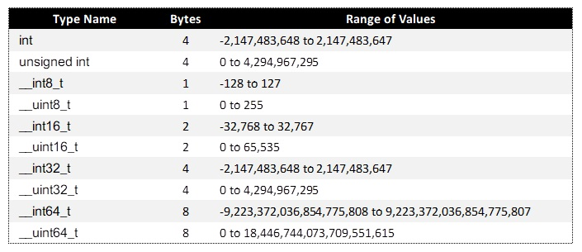
Part 1: Topical Presentation
2. Dimensions of Data Types
Dimensions of Primitive Data Types
Notes:
<click>

Slide 23
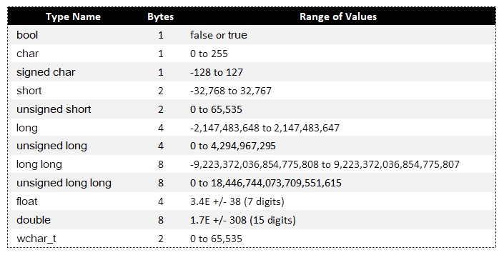
Part 1: Topical Presentation
2. Dimensions of Data Types
Dimensions of Primitive Data Types
Notes:
<click> Now, we don’t have to memorize all these. We just need to know the available type name and we determine the size in bytes and except for floating point types we can also find range of values using… <click>

Slide 24
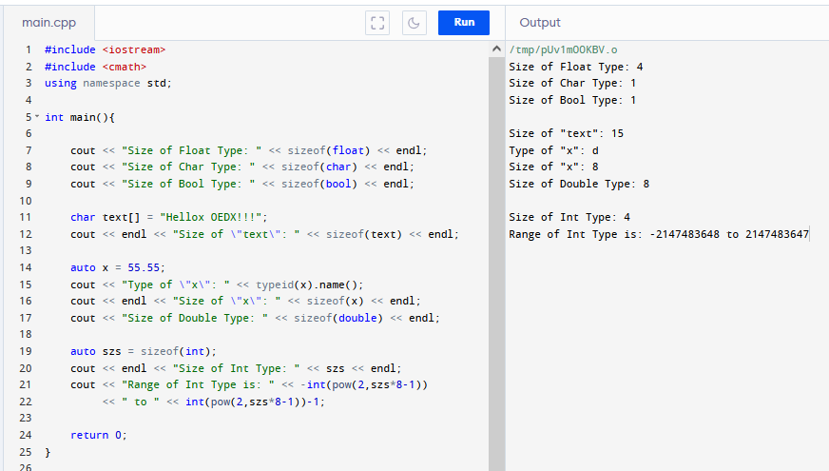
Part 1: Topical Presentation
2. Dimensions of Data Types
“sizeof” and “typeid” Operators
Notes:
Sizeof operator returns the size in bytes of its argument. <highlight> The argument can be a data type <highlight> or a variable name. <highlight>. Here size of char array is 15, we explain about the dimension of derived data type in the next slides. Here, <highlight> x is declared as auto with the value 55.55. If we want to know the type name of a variable we use <highlight> the operator “typeid”. Typeid returns a character code of the type name of a variable, in this case it is “d” <highlight> for double type <highlight>.
We can also calculate the value range of type by converting the size from byte to bits and feeding it as an exponent of 2 <highlight>. As you can see our calculated range <highlight> is exactly the same as the tabulated value range <click>. I will not be detailing more about how the calculation is done. It is sufficed to say that we don’t need to memorize the tables we presented earlier.

Slide 25
Part 1: Topical Presentation
2. Dimensions of Data Types
C++ STL Arrays and Dimensions
Definition of Arrays
An Arrays is a collection of multiple values called elements.
Array elements should be of the same data type
The number of elements is fixed at declaration and cannot be changed.
Array Elements are stored as contiguous block of memory.
Notes:
So far, we have discussed data types that contains only a single value. There also derived data types that stores multiple values in a single variable. One of this derived types is Arrays. <click> Arrays is defined by the properties as follows.<click>(An array is…) <click> (Array elements…) <click> (The number…) <click> (Array elements…). Contiguous means elements are saved side-by-side in memory.

Slide 26
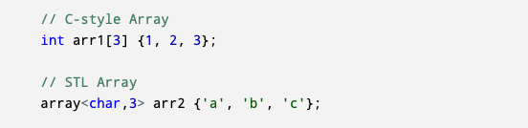
Part 1: Topical Presentation
2. Dimensions of Data Types
C++ STL Arrays and Dimensions
Introducing C++ STL Arrays
STL Array is wrapper class to the C-style array which includes built-in methods making it easier to handle than C-style arrays.
Notes:
In this presentation we will introduce array type provided by the C++ Standard Template Library (STL). <click> (STL Arrays…). The major difference between C-style and STL arrays is the way they are declared. <click> The C-style array <highlight> is declared by providing the type, followed by the number of elements inside square brackets. The STL array is <highlight> is declared by invoking the array class followed by type and number of elements in pointed brackets and lastly the variable name. As you can see, they both can be initialized using unified initialization <highlight> that we have discussed before. However, since STL arrays are not part of the original C language, you have to include the array class header <click> and you have to specify the array class is inside the std namespace. It is good to note that the C++ committee has promoted STL arrays for years now, without much success. C-style array is still quite popular and if programmers want to use STL they go for vector instead of STL array, primarily because vector is a dynamic array. We’ll discuss more about vectors in part 2.

Slide 27
Part 1: Topical Presentation
2. Dimensions of Data Types
C++ STL Arrays and Dimensions
Accessing Elements of Arrays
Index is the position of elements in cell
Arrays is zero-based
n-th element is at index ”n-1”
An example will make this clearer.
Notes:
(Accessing…) In order to access an element you to know its index. <click> (Index…). You have to remember that… <click>. This means that… <click>. <click> (An example…)

Slide 28
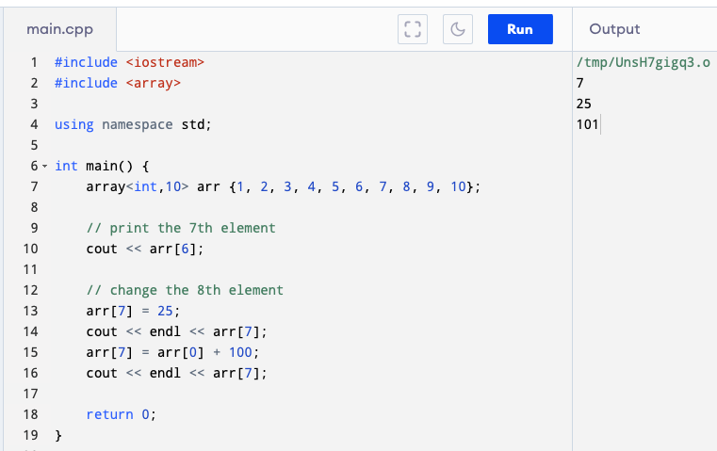
Part 1: Topical Presentation
2. Dimensions of Data Types
C++ STL Arrays and Dimensions
Accessing Elements of Arrays (Example)
Notes:
Here we declare an array of integers from 1 to 10. <highlight>. To access an element we use the square bracket operator <highlight> with the index number inside. But remember that arrays are zero based. So to access the 7th element the index would be index-6. We can also use the bracket operator to modify an element. <highlight> Here we first assign the 8th element a value of 25, and then we again assign it the value of the 1st element (that is the index-0) plus 100.

Slide 29
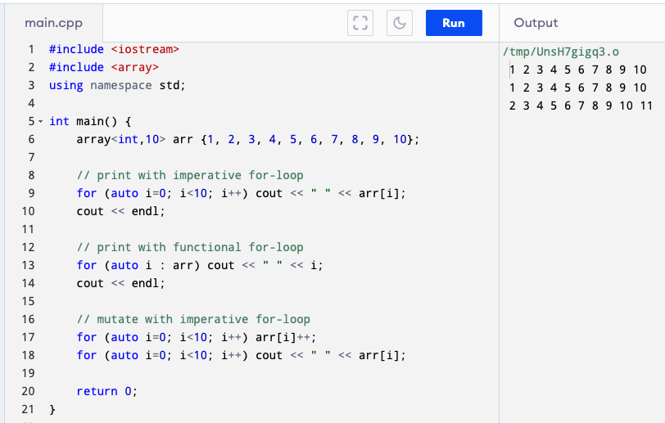
Part 1: Topical Presentation
2. Dimensions of Data Types
C++ STL Arrays and Dimensions
Traversing and Iterating Arrays
Notes:
We can use the all the loop type we’ve discussed to traverse an array. Here we use an imperative for-loop <highlight> and range-based for-loop <highlight>. Notice that the range-based for loop is much clearer but using the imperative for-loop <highlight> we are able to change the values of the arrays elements.

Slide 30
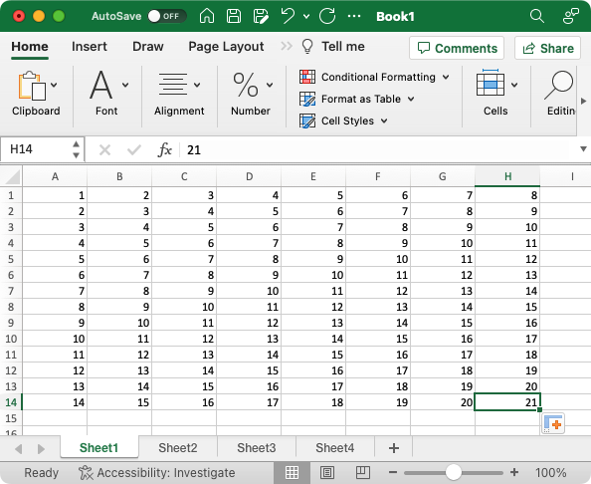
Part 1: Topical Presentation
2. Dimensions of Data Types
C++ STL Arrays and Dimensions
Multi-dimensional Arrays
Notes:
The type of array we are discussing so far has one dimension. <click> We can think of a one-dimensional array as the row in an Excel worksheet <highlight>. A two-dimensional array would be one worksheet <highlight> with both row <highlight> and column <highlight>. A three-dimensional array is like the whole workbook with multiple worksheets <highlight> each have its own rows columns. A four-dimensional array <click> is like a spreadsheet project file folder with several workbooks inside. Higher order dimension array is also possible.

Slide 31
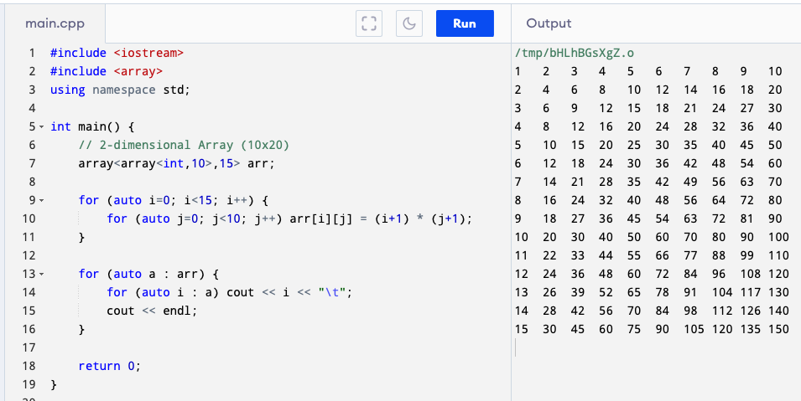
Part 1: Topical Presentation
2. Dimensions of Data Types
C++ STL Arrays and Dimensions
Multi-dimensional Arrays
Notes:
<click>We show here how declare an 10x15 2-dimensional array <highlight> and how to iterate though its elements <highlight>.

Slide 32
Part 1: Topical Presentation
2. Dimensions of Data Types
C++ STL Arrays and Dimensions
Common Methods in STL Arrays
at Method
size Method
fill Method
Notes:
Being a class STL arrays has the advantage having some built-in methods. Here some of the useful methods.
<click> The at method is similar to the square brackets operator, but you cannot use to mutate an element, however it is safe because it will throw an error if you try to access an index <= size of the array.
<click> Size method returns the number of elements of an array.
<click> Fill method assigns its input to all elements of an array.

Slide 33
Part 1: Topical Presentation
2. Dimensions of Data Types
C++ STL Arrays and Dimensions
Common Methods in STL Arrays
empty Method
front Method
back Method
Notes:
<click> empty method returns true if the array is empty and false otherwise.
<click> front returns the value of the first element while,
<click> back method returns the value of the last element.
There are other methods available, but these are the most commonly used.

Slide 34
Part 1: Topical Presentation
1. Through the Loops
Loops is programming is a flow control mechanism that allows a code block to be executed repeatedly, in the process called “iteration”.
Types of C++ Loops
C++ provides for both imperative and functional constructs of looping:
Imperative Loops:
Imperative For Loop
While Loop
Do-While Loop
Functional Loops:
Range-based For Loop
For-Each Loop
Notes:
(Loops is a programming…) <click> (C++ provides for both…) We will discuss both of this constructs. <click>. The imperative loops in C++ are: (Imperative…). <click>. While the functional loops are: (Range…). These are called “functional” because it tries to adhere to adhere the functional principle of “no side effects”. I will explain it when we get there. <click>

Slide 35
Part 1: Topical Presentation
2. Dimensions of Data Types
Derived Data Types and Sizes
Size of Unions
All elements of a Union shares the same memory address. The size of a union is equal to size of the element with the largest size.
Size of Struct without Methods
The size of Pure Structs having no methods is equal to the sum of the sizes of each of its elements.
Size of Pointers and References
The size of pointers/references depend upon the type processor. In a 16-bit system the size would be 2 byte, in 32-bit system pointer/reference size will by 4 bytes, in 64-bit it will be 8 bytes, etc.
Notes:
<click><click><click>

Slide 36
Part 1: Topical Presentation
2. Dimensions of Data Types
Derived Data Types and Sizes
Size of Functions
Size of functions are not particularly defined in C++ STL. The size depends upon the design of compilers and how they optimize functions. The major compilers (GCC, Clang and MSVC) all have different optimization implementations.
Classes and Structs with methods
Since these structures contains methods (or member functions the size of classes and structs with methods should, also be undefined in STL.
Notes:
<click><click> With this we conclude our discussion on data types and we shall move on with the next topic which is… <click>

Slide 37
Part 1: Topical Presentation
3. Introduction to Function Procedures
Function is a “named” code block that only runs when it is ”called”.
Function Syntax
Invoking / Calling Function
Passing Parameters
The Main Function
Special Types of Functions
Default Values and Overloading
Function Declaration / Prototyping
Function Signature and Function Pointers
Lambda Functions
Notes:
We now come to the last topic of part 1, which is (Introduction…) <click>. Function is one of the most important concepts in programming. It is a way of grouping snippets of code for future use. Think of a function as like the mathematical functions we learned in high school algebra. Mathematical functions accepts value and returns a value. Except in programming functions may not accept a value and may not return a value.
In this section we will discuss about the following. <click> <click> …

Slide 38
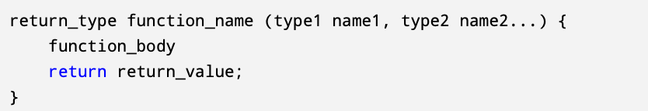
Part 1: Topical Presentation
3. Introduction to Function Procedures
Function Syntax
Return Type
Function Name
Parameters
Function Body
Return Value
Notes:
Functions in C++ have the following syntax. Function starts with…
<click> The return type, which is the data type of the output of the function. Followed by…
<click> The function name, which the name to be used to call the function. Followed by…
<click> The parameters, which are variables representing the input/s of the function. They should be proceeded by their types, separated by commas and enclosed in parenthesis. A function can have none, one or more parameters. Next is…
<click> The function code block or body is where the functions logic, statements and calculations codes are written.
<click> Normally written at the end of the function is the keyword “return”, which says that the function is ending and returning to caller, followed by the output or return_value which should have the data type as the return type at the beginning of the function.

Slide 39
Part 1: Topical Presentation
3. Introduction to Function Procedures
Invoking / Calling a Function
To call a function we just need to write its name in our code followed by, enclosed in parenthesis the input required by the function.
The function’s input is also called the function arguments.
An example will make this clearer.
Notes:
Invoking or Calling a Function is easy. <click> (To call…). The input should have the same types as in the function parameters. <click> (The function…) <click> (An example… ) <click>

Slide 40
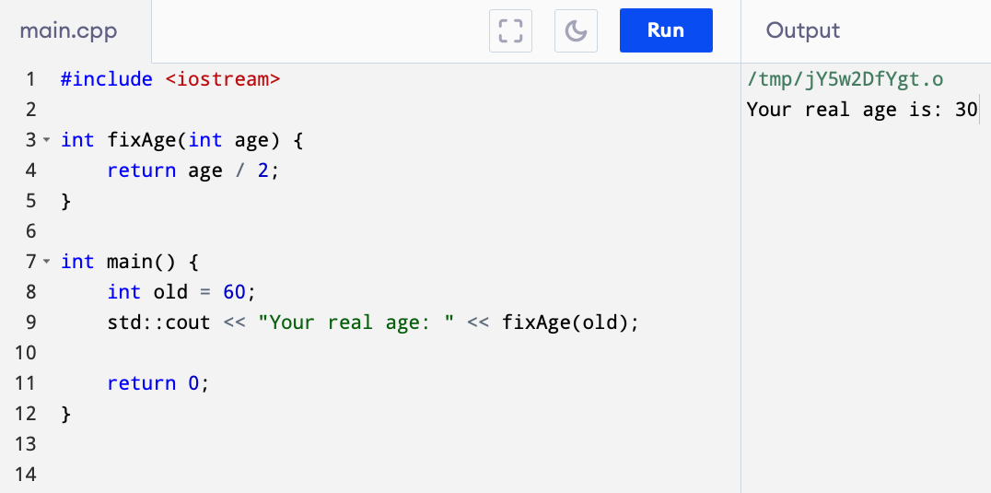
Part 1: Topical Presentation
3. Introduction to Function Procedures
Invoking / Calling a Function (Example)
Notes:
In this example, <highlight> how easy it is to call a function.

Slide 41
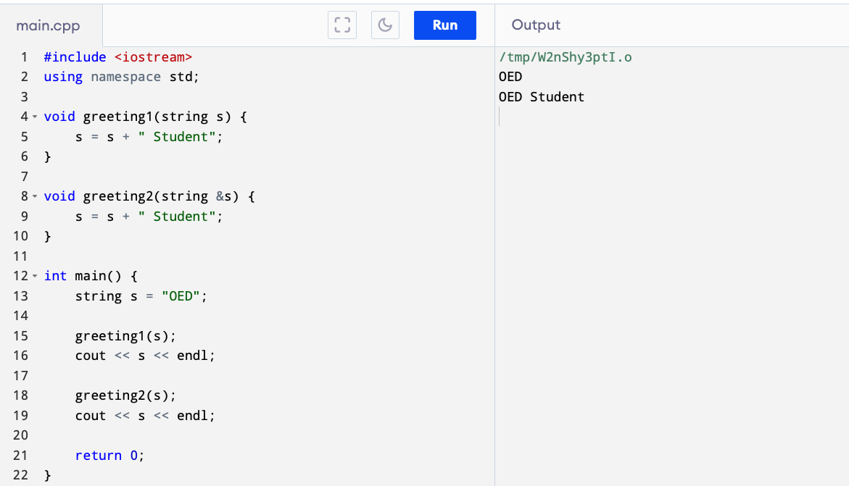
Part 1: Topical Presentation
3. Introduction to Function Procedures
Passing Parameters
Pass by Value
Pass by Reference
Notes:
Function arguments can be passed to the parameters in 2 ways. <click> (Pass…). In pass by value only a copy of the argument is passed to the function, hence, the function cannot change the original variable. <click> (Pass…) In pass by reference, a reference of the argument is passed to the function, any change in the argument by the function will change the original variable. <click> In the example below, the first function <highlight> is having its argument pass by value, while the second is pass by reference <highlight>. The first function has no affect the value of the original variable <highlight>, while the second changed it.<highlight> <click>

Slide 42
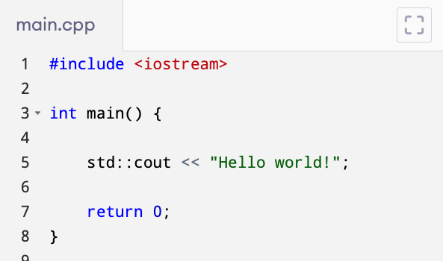
Part 1: Topical Presentation
3. Introduction to Function Procedures
The Main Function
Main function is the entry point of the program
Main function must be global
Main function may or may not accept accept an argument
MUST return an integer
Notes:
All C++ programs contains a function called <highlight> “main”. <click> (Main function…) This means that this is the function that system automatically calls when a program is started. That is why <click> (Main function…) . It cannot be inside a class or function or any other data structure. Otherwise, the system will not be able to find it. <click> (Main function…) but it <click> (MUST…). A return value of zero means the program exits successfully. Any other number means the program existed with error.

Slide 43
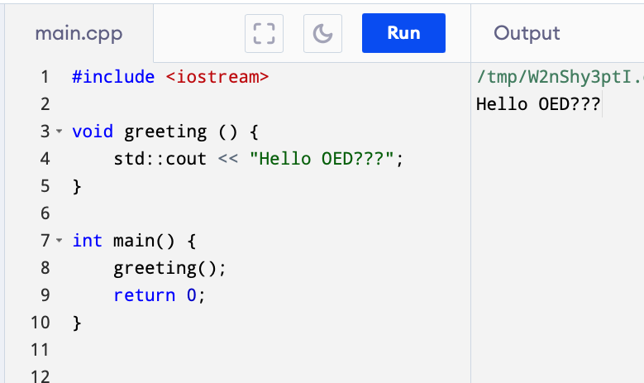
Part 1: Topical Presentation
3. Introduction to Function Procedures
Special Types of Functions
Void Function
Notes:
We will now have a rundown of some special types functions that you may encounter. First is <click> (Void..) Mathematically all functions should return a value. But not in C++. A void function is a function that doesn’t return a value. In some programing language like Pascal this is distinguished from function and is called a procedure. Void functions are proceeded by the keyword void <highlight>.

Slide 44
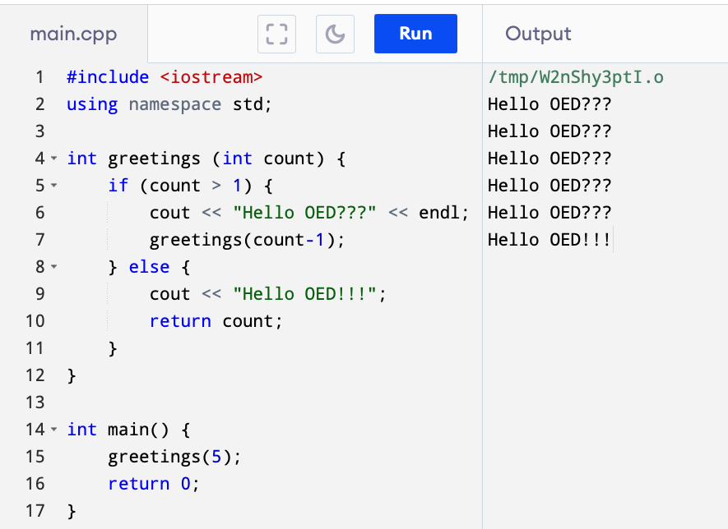
Part 1: Topical Presentation
3. Introduction to Function Procedures
Special Types of Functions
Recursive Function
Notes:
A recursive function is a function that calls itself <highlight>. In functional programming it is preferred over looping because it is much clearer. In an imperative language like C++ however, where the compiler does not support recursive function optimization recursive function for large number of repetition will quickly crash the program. You may also make your own recursive function optimization, but that is an advanced concept for this presentation.

Slide 45
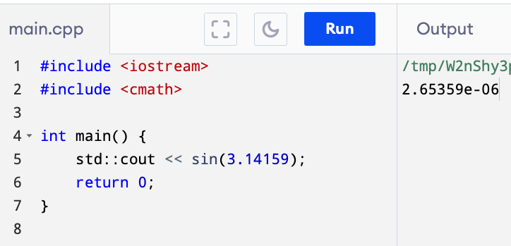
Part 1: Topical Presentation
3. Introduction to Function Procedures
Special Types of Functions
Built-in Functions
Notes:
C++ STL provides a a ton of built-in functions you only need to know where the functions are. In this example the sine can be found in the cmath library hence the cmath header <highlight> should be included. Use of built-in functions are preferred instead of inventing your own because built-in functions are optimized by the compiler and is well tested.

Slide 46
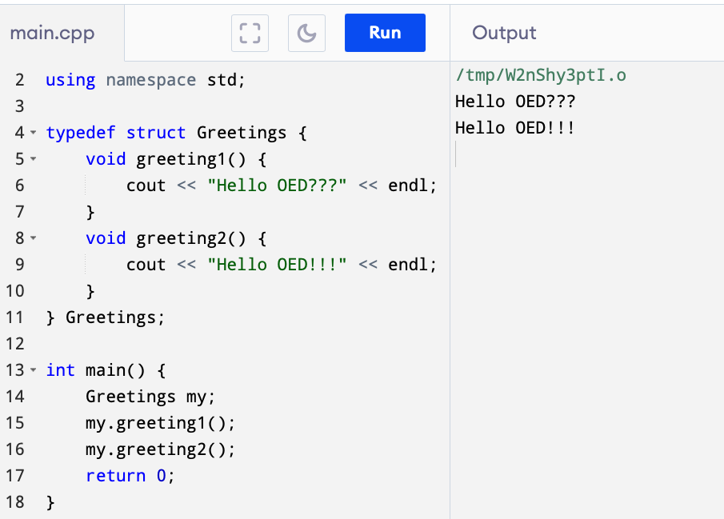
Part 1: Topical Presentation
3. Introduction to Function Procedures
Special Types of Functions
Methods
Notes:
Functions that are found inside a struct or class is called methods. To call a method the <highlight> ”dot” notation is used.

Slide 47
Part 1: Topical Presentation
3. Introduction to Function Procedures
Default Values and Overloading
Default Values are the values given to a parameter when no argument is provided to it in the function call.
Overloading is way of assigning different functionalities to a function of the same name, depending upon the type and number of parameters.
An example will make this clearer.
Notes:
<click> (Default…) <click> (Overloading..) <click> (An Example…)

Slide 48
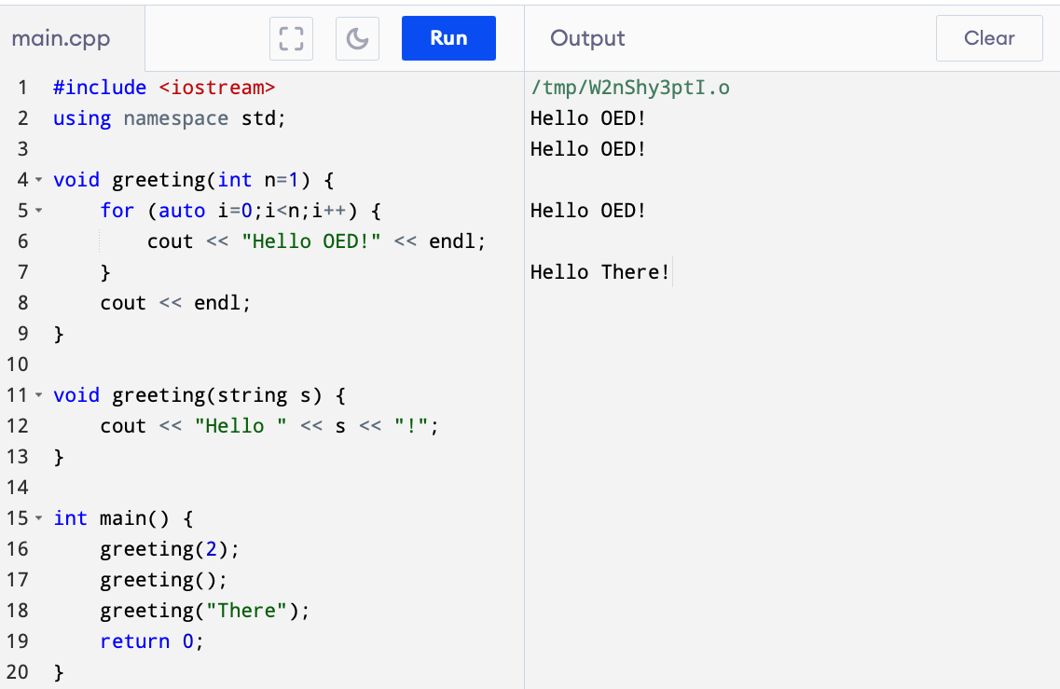
Part 1: Topical Presentation
3. Introduction to Function Procedures
Default Values and Overloading (Example)
Notes:
In this example the function input is given a default value of 1 <highlight> so that when it is called without argument <highlight> it will be invoked as if the input value is 1. The function is also overloaded <highlight> with a different parameter type. And when called with the other type it will run the correct function version.

Slide 49
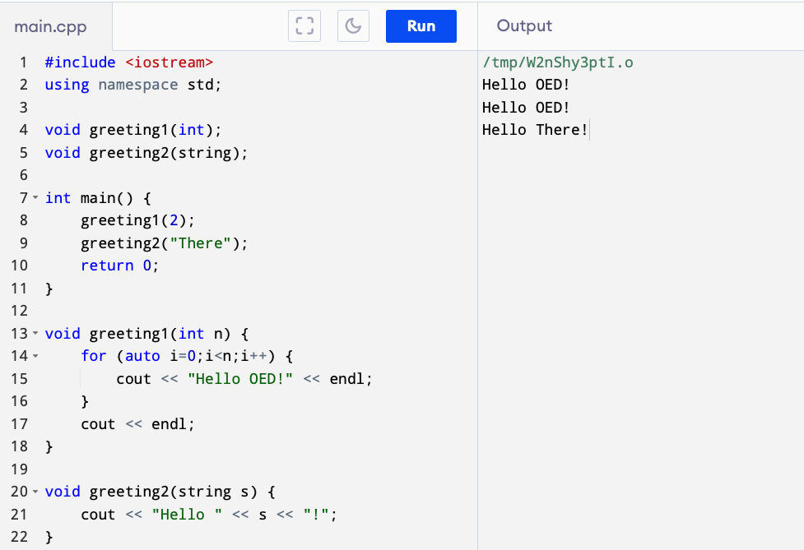
Part 1: Topical Presentation
3. Introduction to Function Procedures
Function Declaration / Prototyping
Prototyping is a declaration of a function without implementation.
Notes:
All functions we have implemented so far is written on top of the main function. This is because the C++ compiler reads the source code file from top the bottom. The human mind thinks differently, though. We want to see first what the program supposed to do (which is explained in the main function) and then look-up on the supporting functions. The solution is prototyping. <click> <click> In the example below functions are declared/prototyped on top of main <highlight> and implemented below main <highlight>. When the compiler reads this file it will understand that we expect an implementation of the declared functions somewhere in the source code.

Slide 50
Part 1: Topical Presentation
3. Introduction to Function Procedures
Function Signature and Function Pointers
Function Signature is the function declaration strip-out of the function and parameter names.
Function Pointer is a pointer to a function with the same signature.
An example will make this clearer.
Notes:
<click> (Function…) So, if we have this function <click>, the signature is this <click>. <click> (Function…) To create a function pointer we begin with a function signature <click> and we then insert the pointer name in between the return type and the parameter types <click>. The pointer name should be enclosed in parenthesis. Since pointers is transferable, function pointers can be made to point to any function as long as it has the same function signature. <click> (An example…)

Slide 51
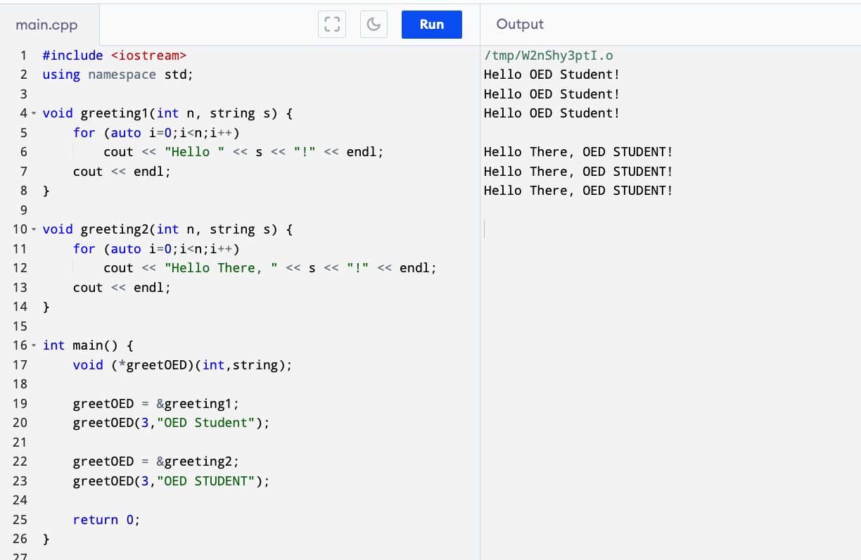
Part 1: Topical Presentation
3. Introduction to Function Procedures
Function Pointer (Example)
Notes:
In this example 2 functions of different functionality but of the same signature are created <highlight>. We then create a function pointer <highlight> with the same signature. We then assign the function pointer <highlight> to the address of each of the functions we previously defined and run it. Function pointers are very useful in Menu programs.

Slide 52
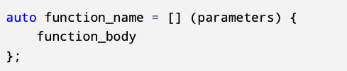

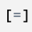

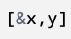
Part 1: Topical Presentation
3. Introduction to Function Procedures
Lambda Function
A lambda function is a way of defining function inside another function.
An example will make this clearer.
Notes:
<click> (A lambda…) It is usually used to define a function which is used only one time and/or deemed too trivial to be worthy of declaring as global. The syntax of a lambda function are as follows: <click> It starts with the keyword “auto” <highlight> followed by the function name <highlight>, followed by the assignment operator <highlight>, followed by the capture operator <highlight>, and lastly the function body <highlight>. The capture operator tells which variables from the host function can be accessed by the lambda. An empty capture <click>, means no variable from the host can be accessed, <click> a capture with equal sign means all variables from the host will be captured by value. <click> a capture with ampersand means all will be captured by reference. <click> We can also specify only specific variables to be captured, those with ampersand are captured by reference and those without are captured by value.

Slide 53
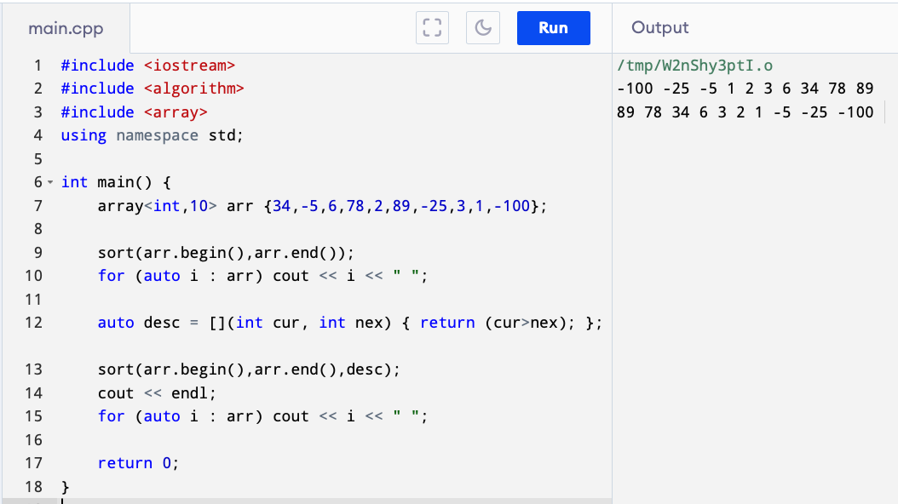
Part 1: Topical Presentation
3. Introduction to Function Procedures
Lambda Function
Notes:
In this example we declared an unsorted array of integers. <highlight> We then apply the built-in function “sort” <highlight>. However, the sort function by default sorts a collection in ascending order. To sort it in any other way, in our case descending, we should feed sort with an optional third argument explaining how the sort shall be done, in our case, the current item should be greater than the next item. But the third argument is required to be a function. We don’t want to waste to write a function that we will use only once so <highlight> we created a lambda function instead and then input it to the sort function to get the desired result <highlight>. <click>

Slide 54
END OF PART #1
Notes:
We now come to the end of Part 1. Part 2 will be about solving the exercise problem accompanied by this Course Project. Thanks and see you in Part2…

Slide 55
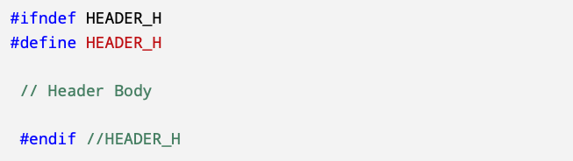
Part 2: Programming Exercise
1. Prerequisite Topics
Understanding of Course Modules
Completed Part 1
”pragma once” Directive
Notes:
Hello again, this is Ramon. And now we begin part 2 of our presentation where we are going to solve the programming exercise included in this Course Project.
But before we go to that <click> we need to talk about the prerequisite topics that we need know, so we can understand the solution we proposed and we don’t have to explain it much in the discussion of our solution.
First we assume that we have already understood both the <click> course module and have read the full part 1. Next we have the following concepts that we haven’t discussed yet.
<click>(pragma…) In order to ensure that a header is only included once in the program we use the following directive <click>. Aside from being very long, this directives are prone to errors specially if we are used to copy-pasting codes. If we misspelled one token here the whole directive will not work. Instead, the recommended method to avoid header duplication is the directive <click>, which does exactly the same effect. We will use this throughout our solution.

Slide 56
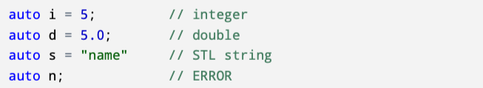
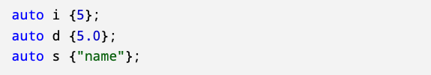
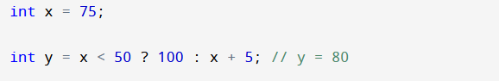
Part 2: Programming Exercise
1. Prerequisite Topics
The “auto” Keyword (Type Inference)
Uniform Initialization
Ternary Operator (3rd Type of Conditionals)
Notes:
C++ is a statically typed programming language. This means that once the variable declared we cannot change its data type or assign to a variable of different data type. Since 2011, however C++ introduce <click> type inference, in which programmer need not specify the type of the variable and allow the compiler to infer the correct data type. One way to do this is through the key word auto. With the auto keyword, the compiler is able to infer the data type by the data type of the value the variable is initialize with. The variable should be initialized upon declaration, though, otherwise it will return an error because the compiler will not be able to guess the data type.
<click> Uniform initialization is a way to initialize variables without using the assignment operator. Instead of equal sign the value of initialization is enclosed in parenthesis. This is actually a good thing because it forces compilers to optimize initialization. Remember that C++ compiles to assembly first before compiling to machine code. In assembly initialization and assignment are 2 distinct operations.
Aside from IF and SWITCH, <click> there is a 3rd kind of conditional available in C++ called Ternary Operator. The ternary operator begins with a condition <highlight> followed by a question mark <highlight>, followed by the statement if condition is met <highlight>, followed by a colon <highlight> and the statement if the condition is falsified <highlight>. This is like a concise IF-statement. However, unlike IF the result of the ternary operator can be assigned to a variable. Here the value 80 is assigned to variable “y” because of the ternary operator. There are other types of conditionals in C++, like ”pattern matching” and “range-based switch statement.” But those are beyond the scope of this presentation.

Slide 57
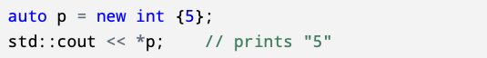
Part 2: Programming Exercise
1. Prerequisite Topics
Vector Class
“nullptr” Pointer
The “new” Keyword
Notes:
<click> A vector is also called a dynamic array. Yes contrary to what we are told the module, there is dynamic array in C++. Dynamic array means it doesn’t have fixed size. You can add more elements to a vector, increasing its size at will. it is declared the same way as STL array except that the number elements is not specified. You also have to <click> include the vector header to use vector.
<click> ”nullptr” is a pointer to an empty address. It was also introduced in 2011. It is an improvement of keyword “NULL” in older C++ which only an alias to the number 0. This caused a lot confusion that’s why nullptr is invented. It is a real pointer not the value zero. Nullptr is part of the new “safe” smart pointers introduced in C++11 and C++17.
<click> The ”new” keyword is not actually “new”. It’s been with C++ since C++98. It is a way to create a pointer to a class. What is ”new” though is that beginning C++17 you can now create pointers <click> to any data type, even primitive data type, using the “new” keyword.
With this we are ready to tackle the exercise problem…

Slide 58
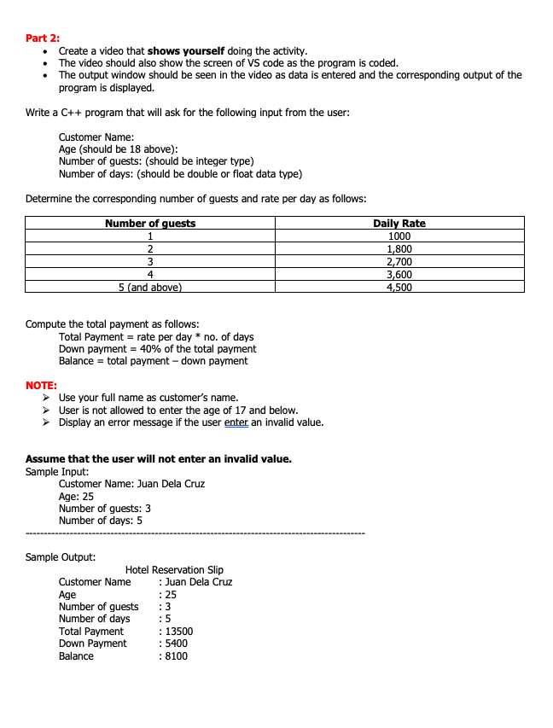
Part 2: Programming Exercise
2. Statement of the Problem
Notes:
Here is the statement of the problem. Let’s zoom it so we can read it better…

Slide 59
Part 2: Programming Exercise
2. Solution to Programming Exercise
First, instead of re-writing the code. I will present to you the finished solution and then we will explain each code one-by-one. This is to save time and minimize error.
Second, I will not be using VSCode. For small projects, I prefer to use a ”pure” text editor, so that I would have better control of the compiler commands. I will be using Sublime Text. And, for compilation I will be using the g++ version provided by Clang, which in turn is the default C++ compiler suit in MacOS.
Notes:
Before I switch to the solution I want to propose the following <click> <click> With that let’s dive in…

Slide 60
Thank YOU!!!
Notes:
We come to the end of this presentation. Thank you very much for your time. Thanks very much to my professor for giving the chance to prove “I can do this.” See you again next time if there is a next time.

